Slide 1
TMS
P.E./Health DEPT.
Tonya McDermott, Mike Radlbeck, Greg Talbot

Slide 2
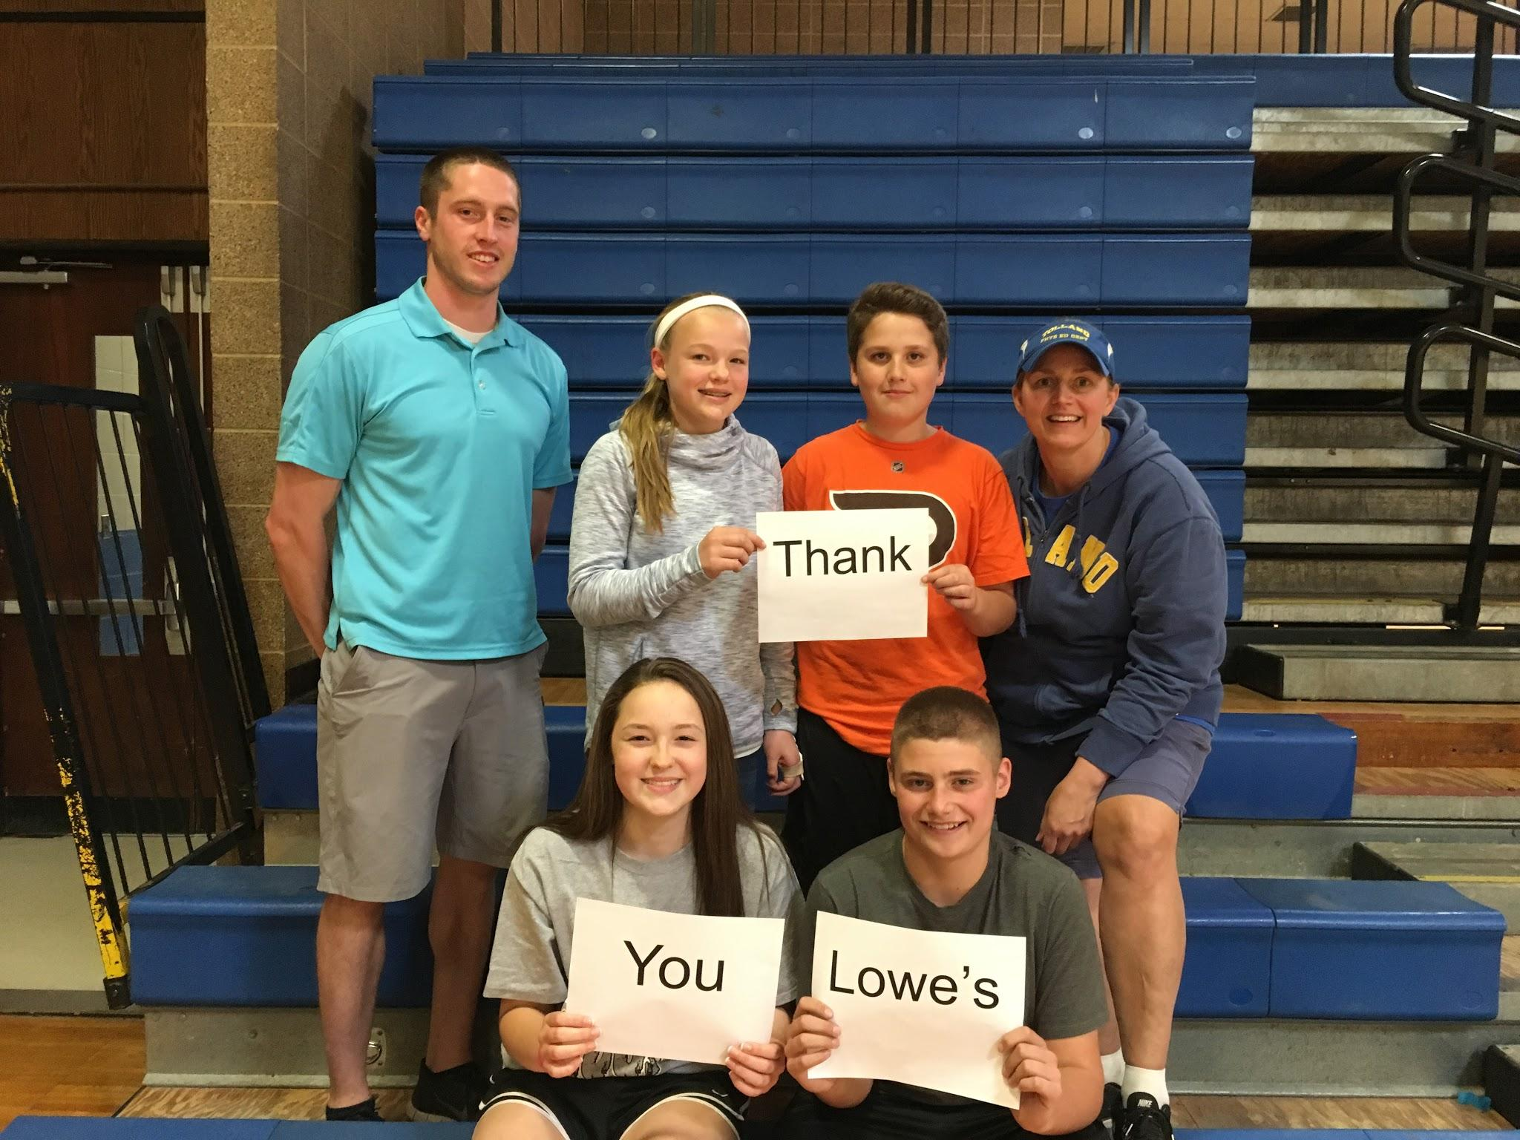
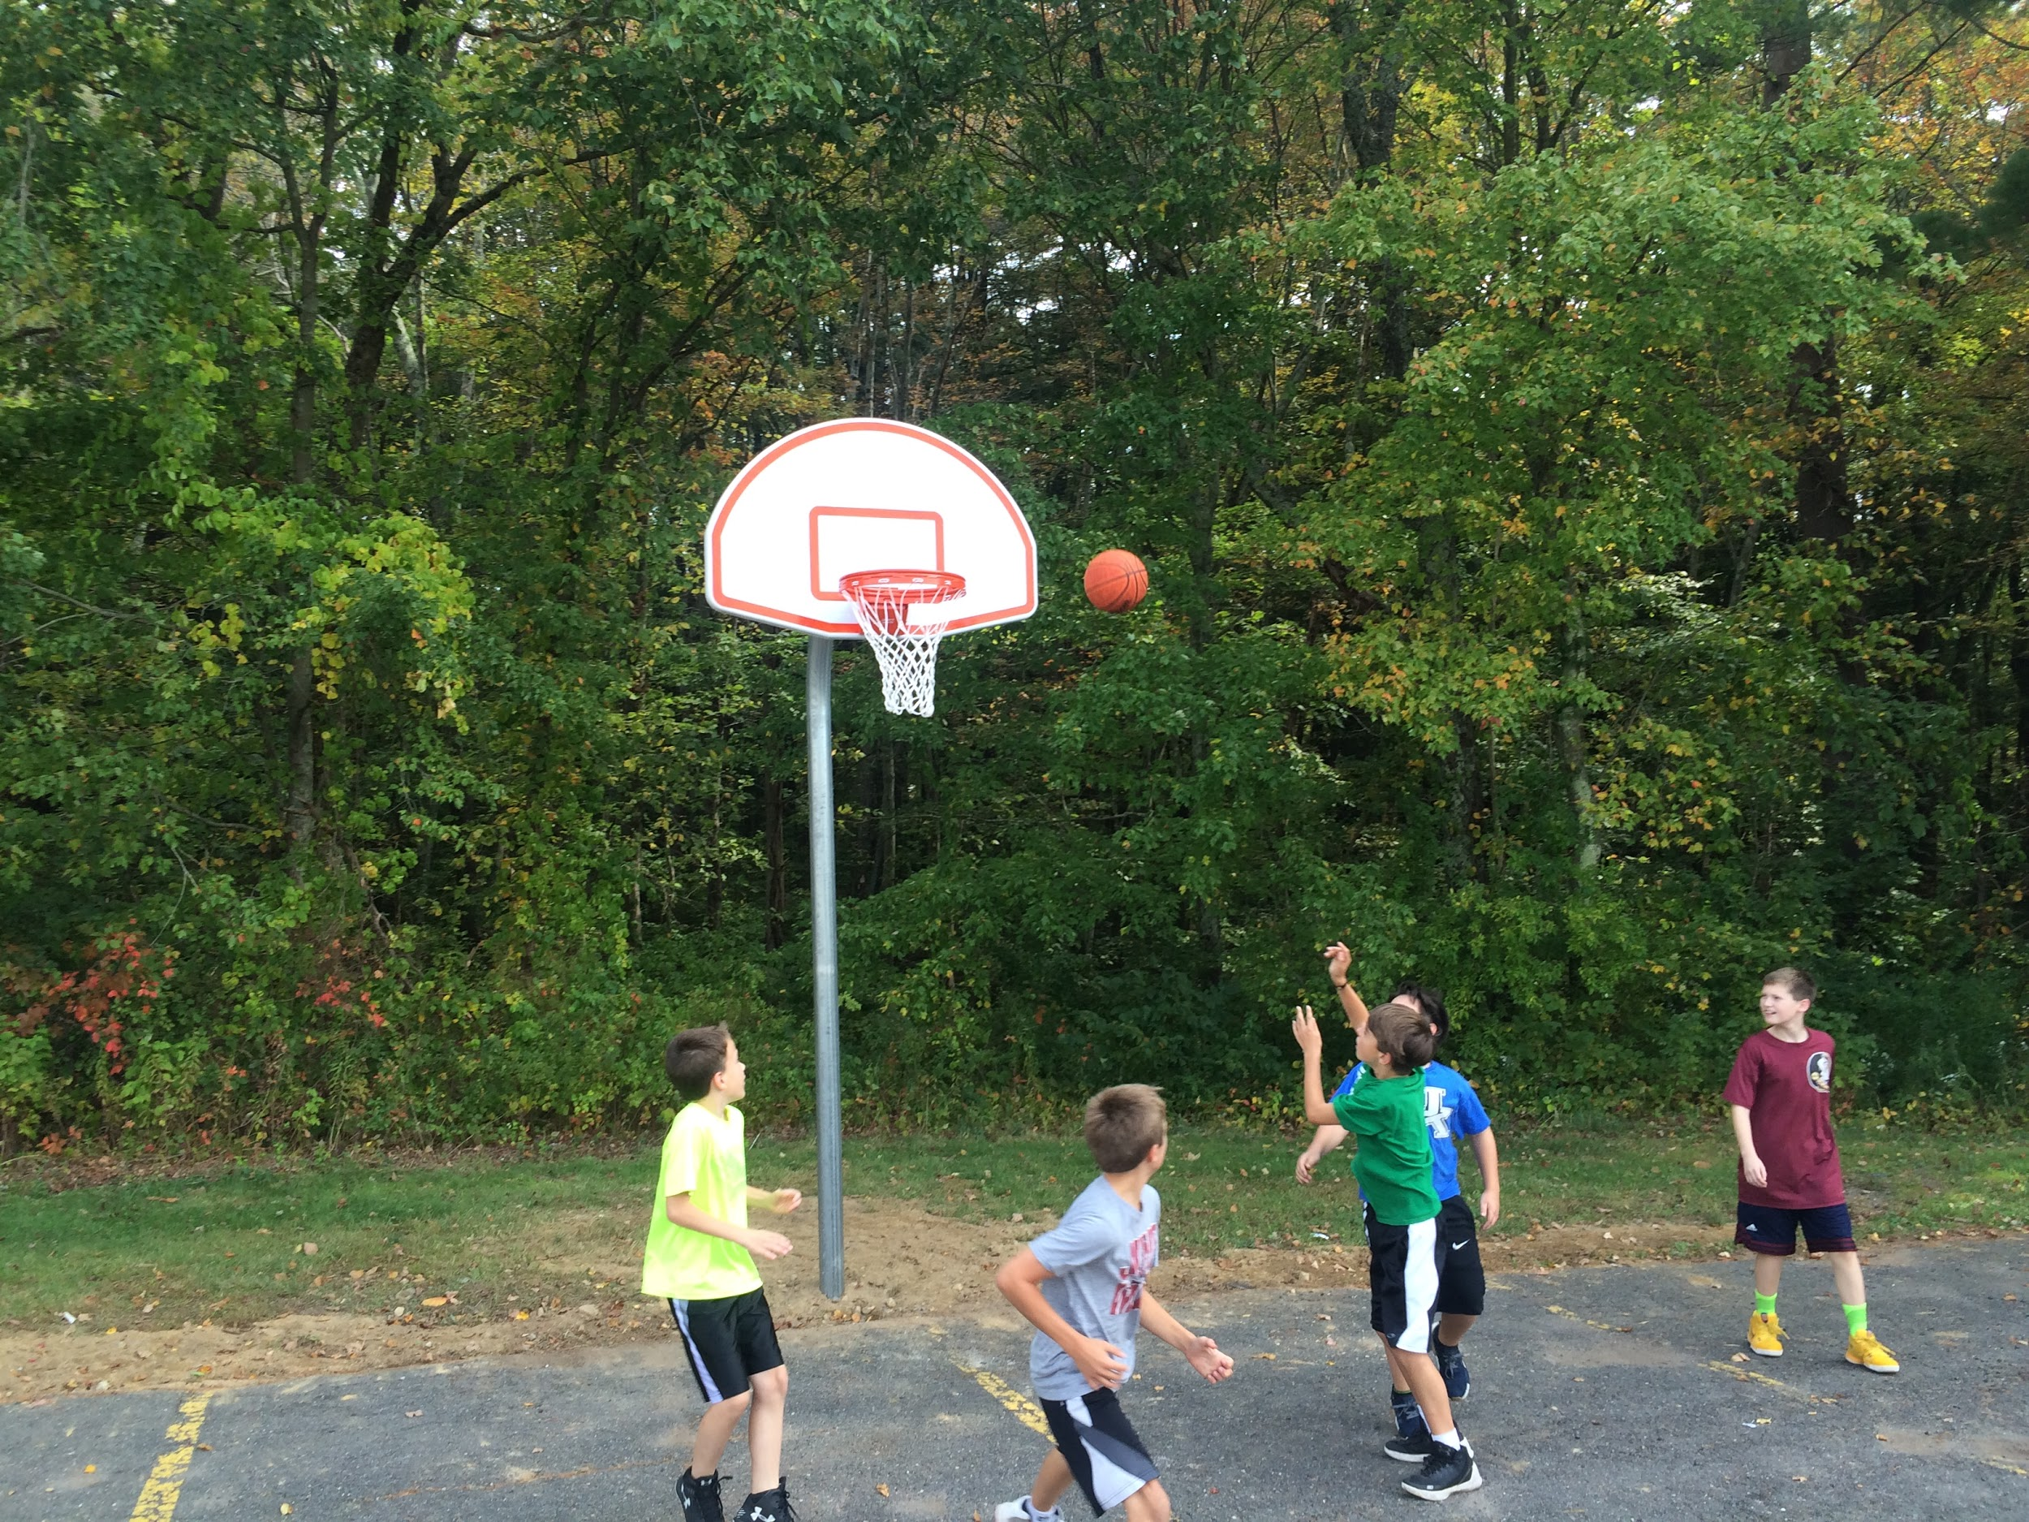
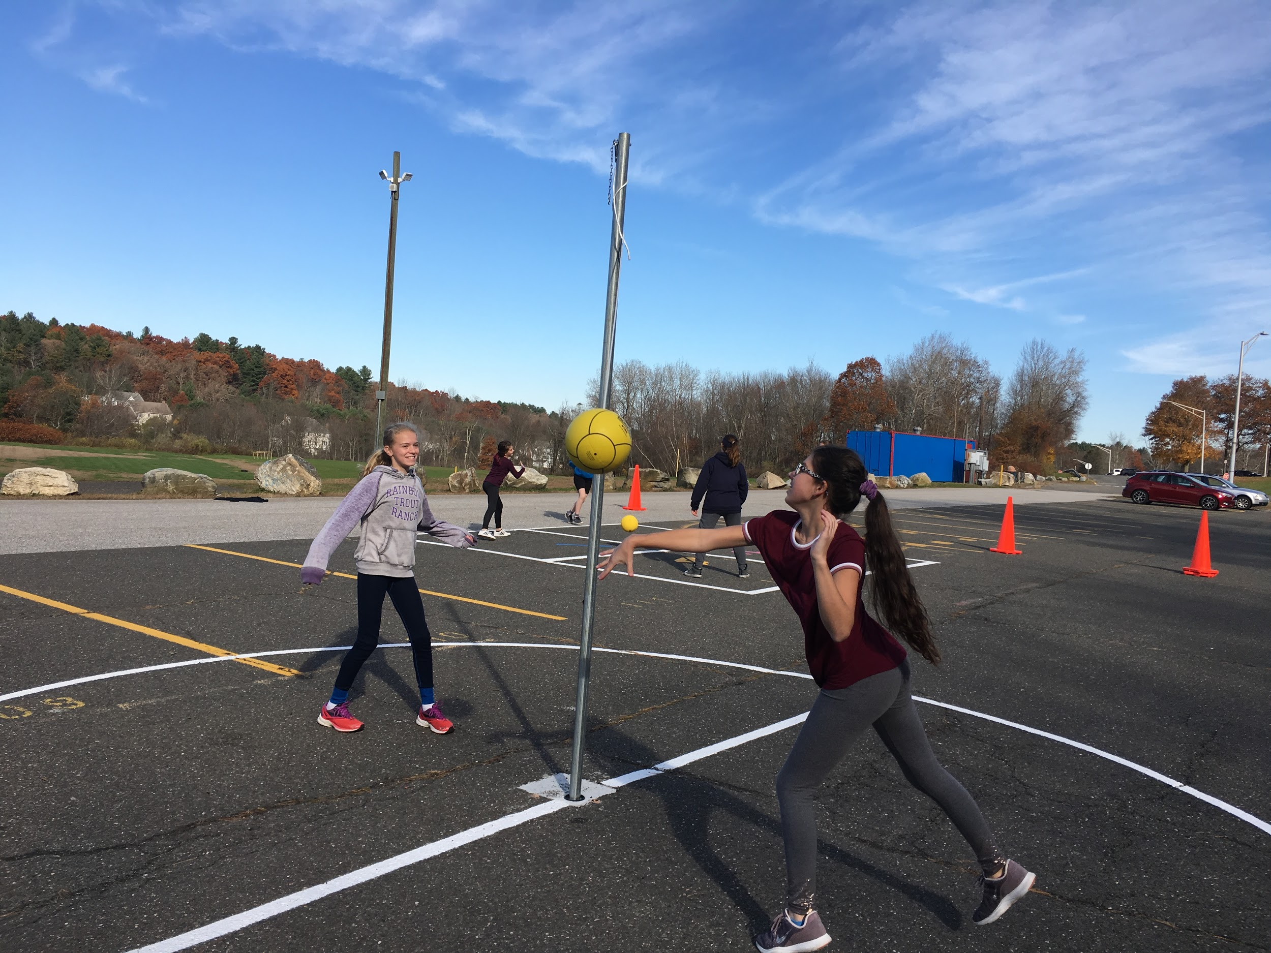
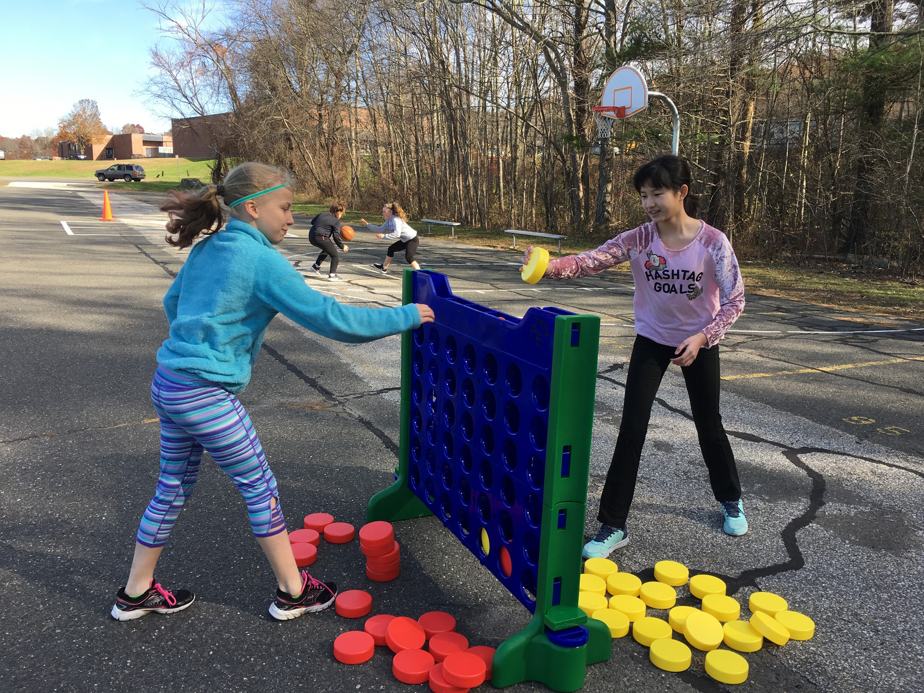
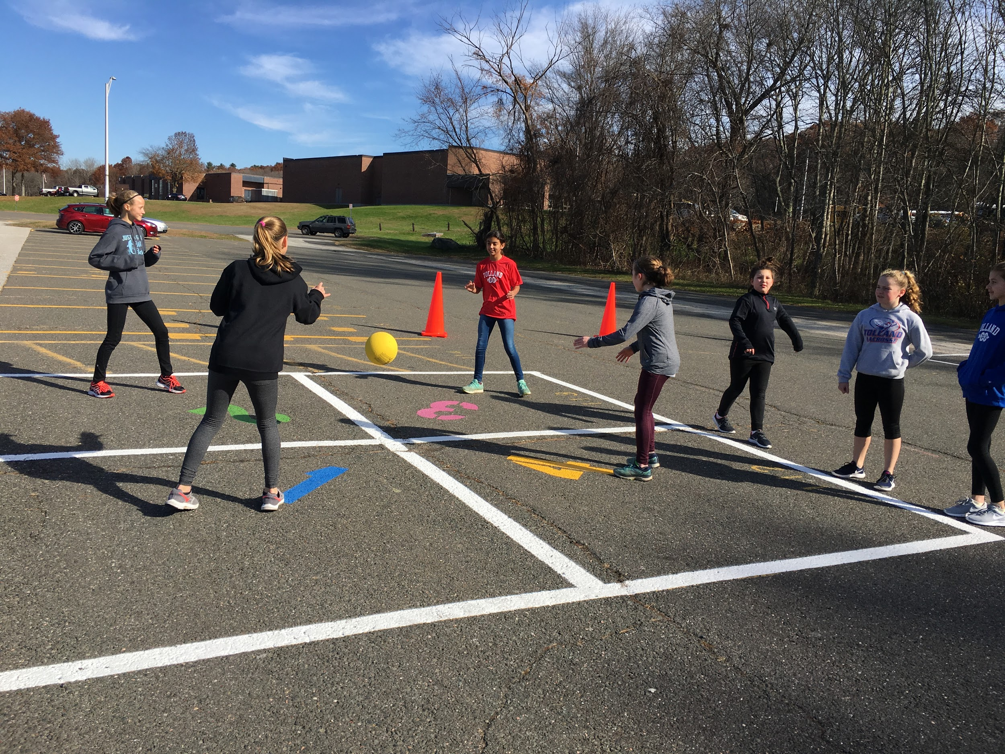
What’s new? PLAY AREA
2 Basketball Courts
2 - 4 Square Courts
Double Dutch Ropes
4 Tetherball Courts
Giant size Connect 4
2 Shuffleboards
Lowe’s and PTO

Slide 3
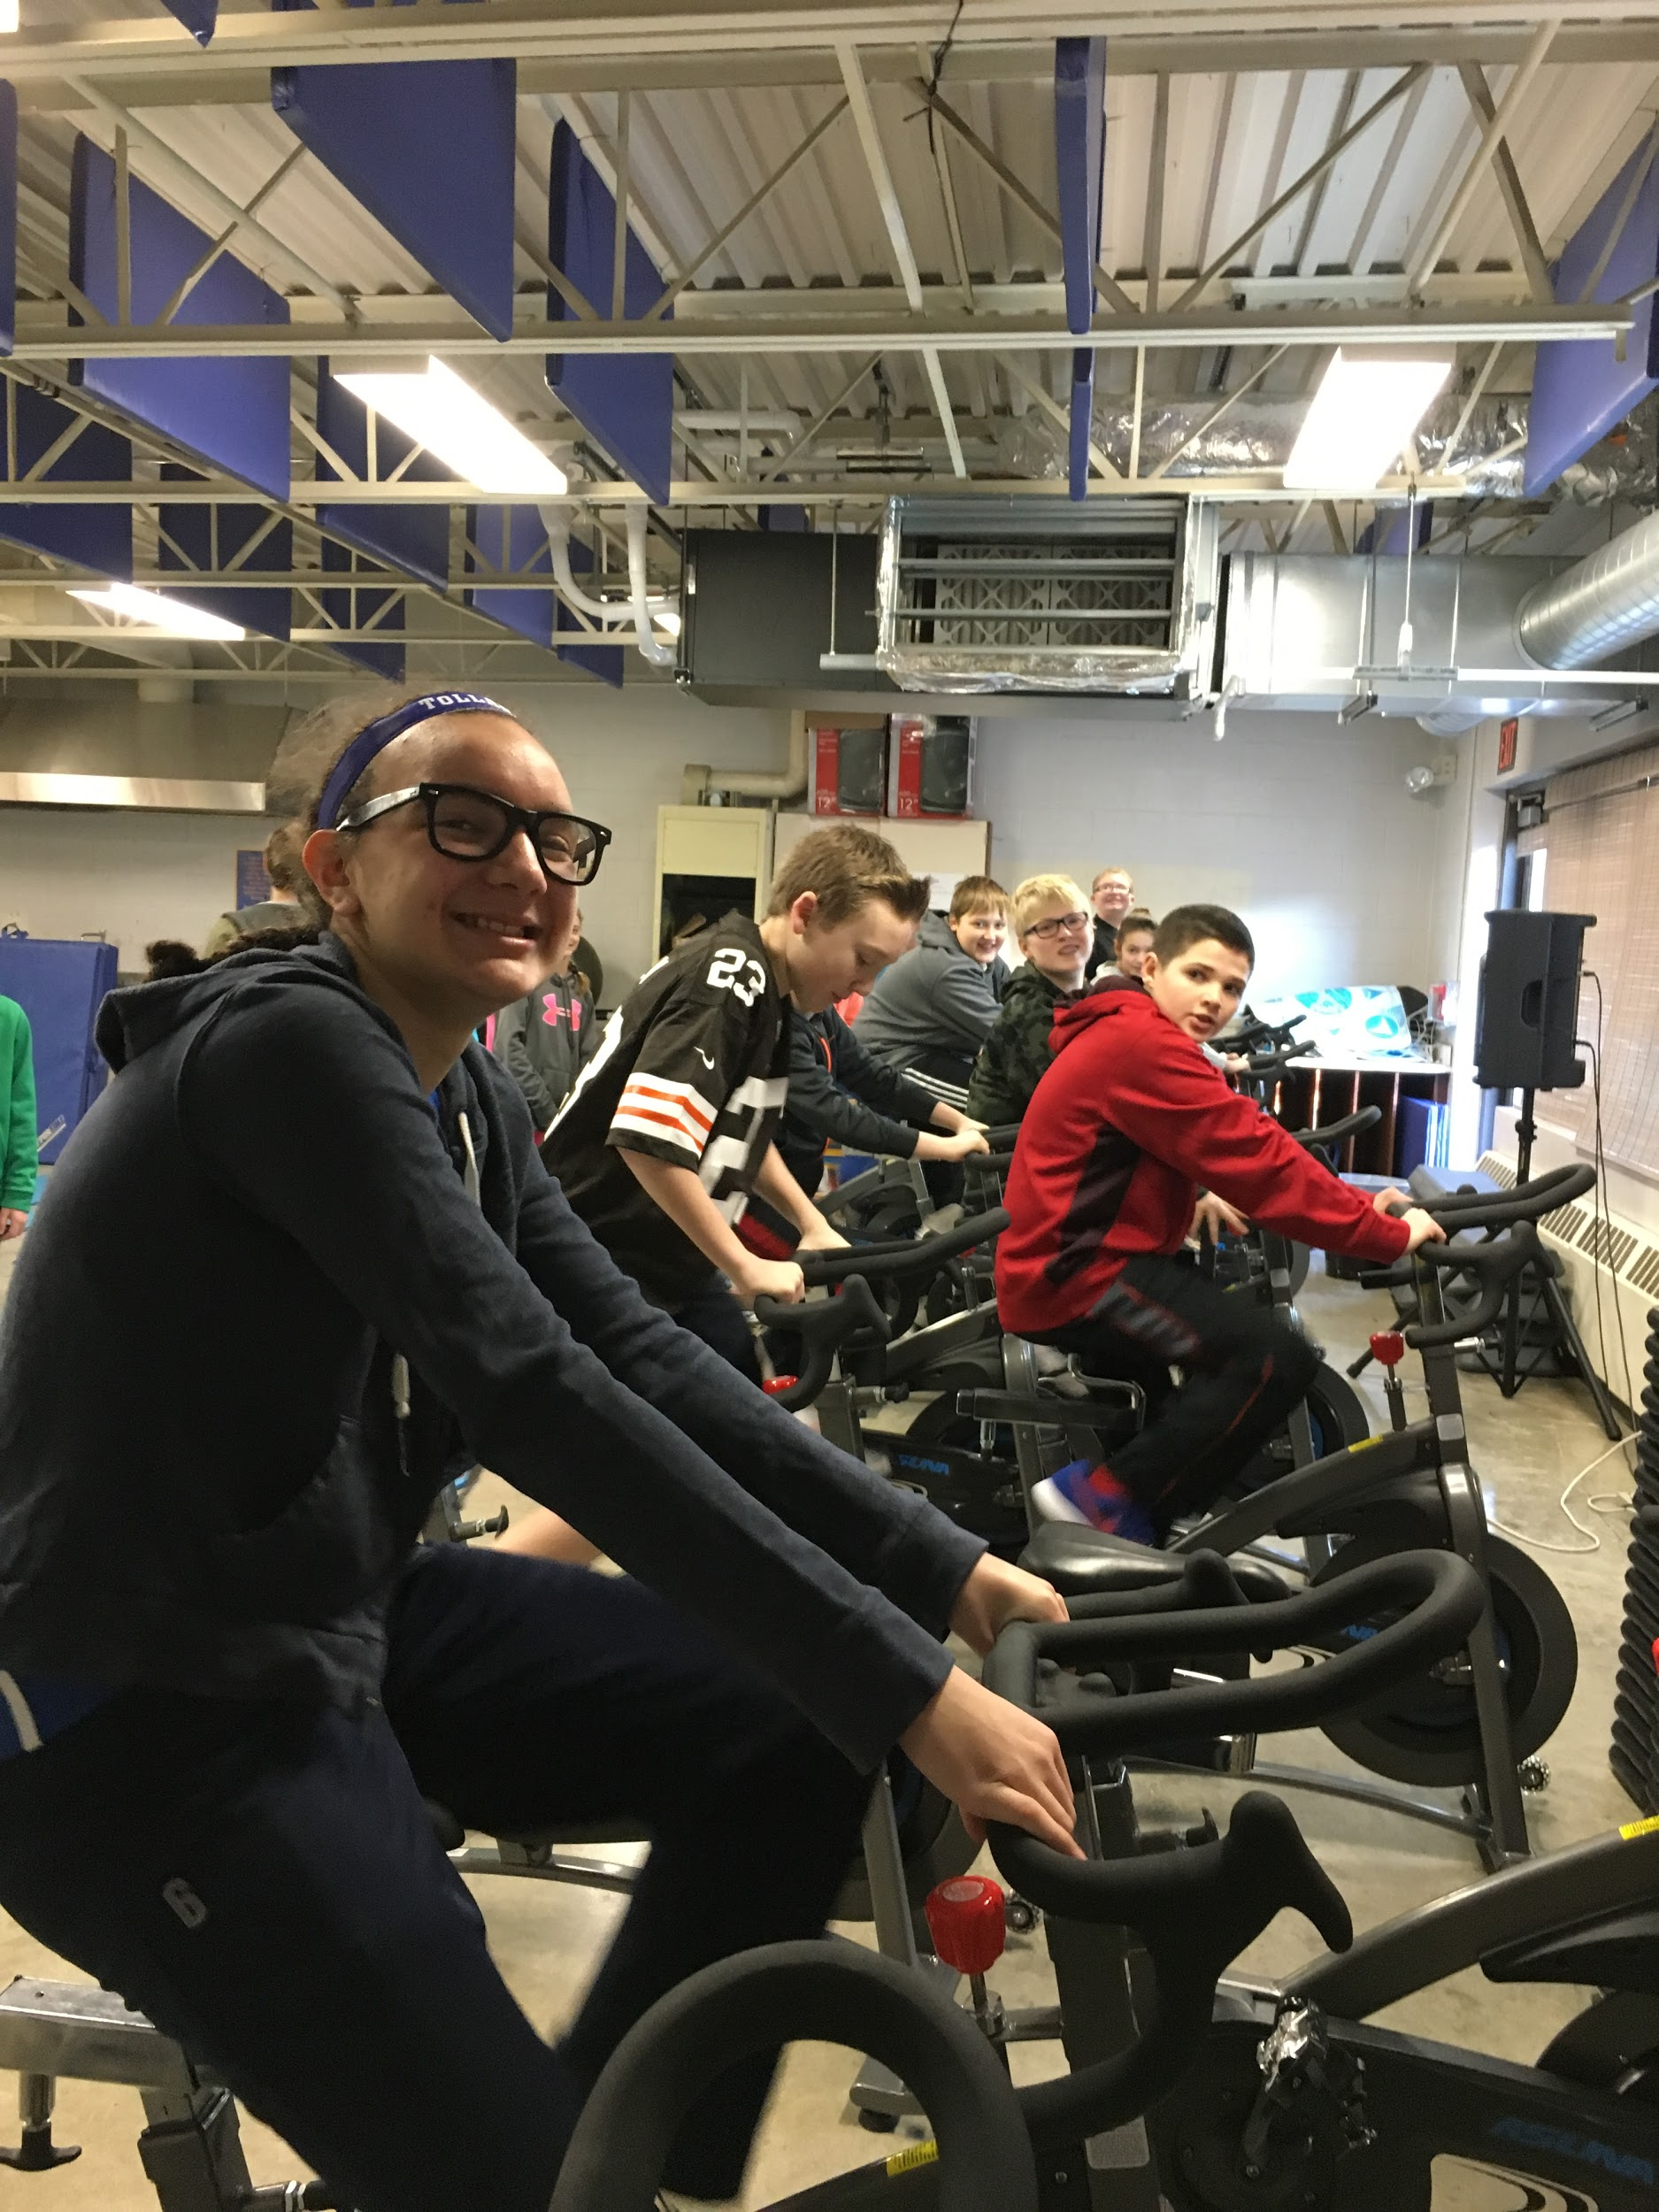
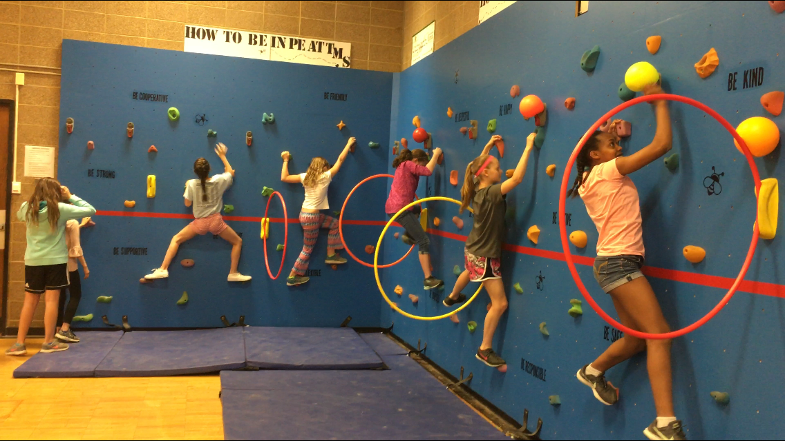
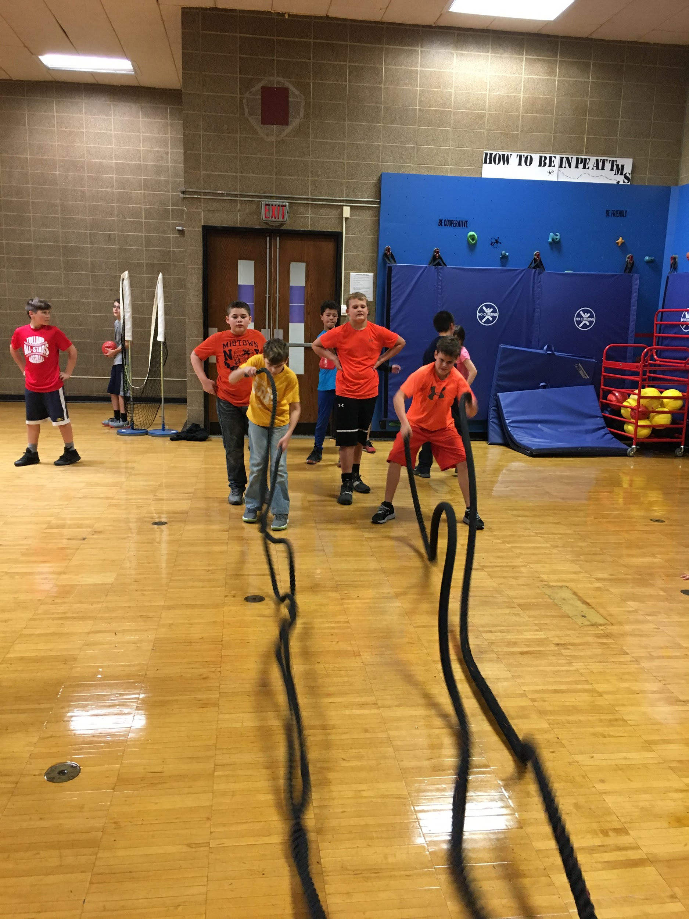
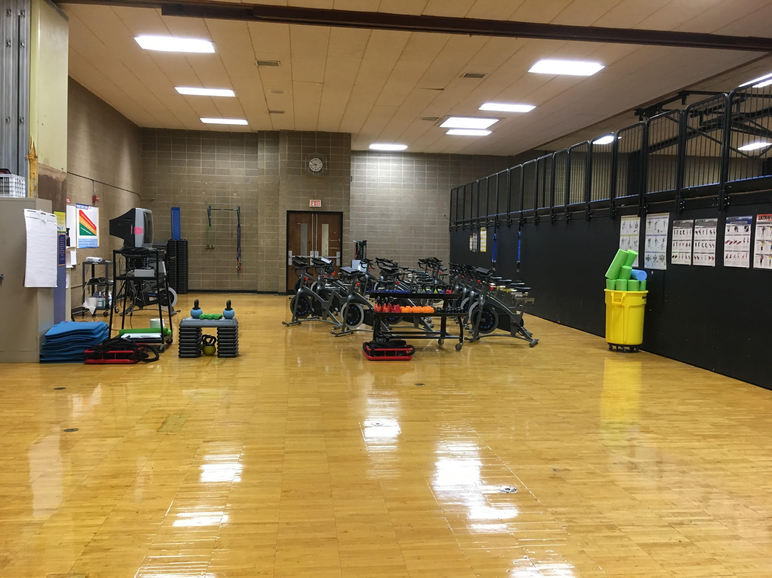
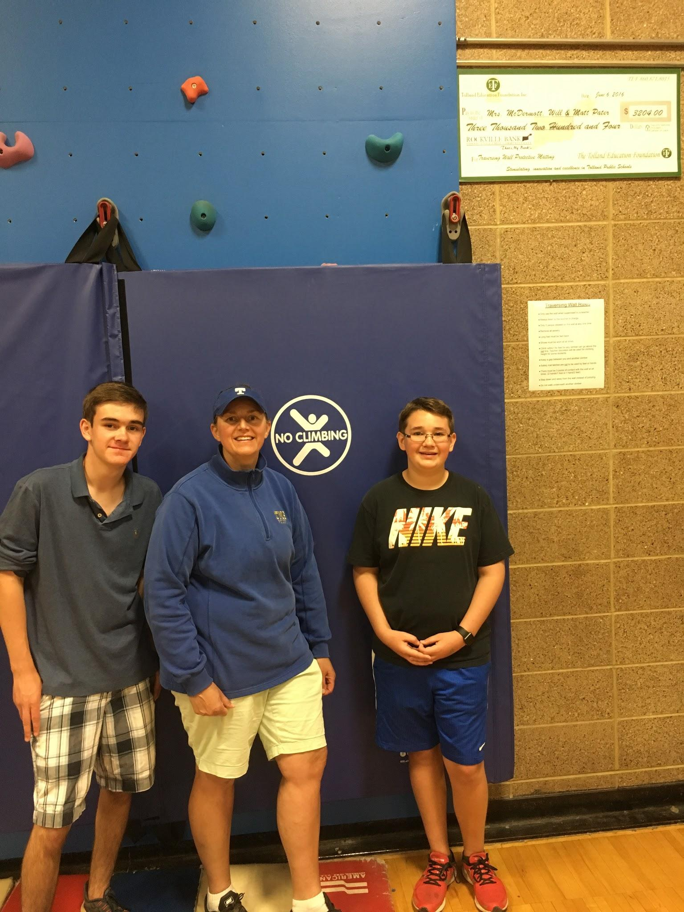
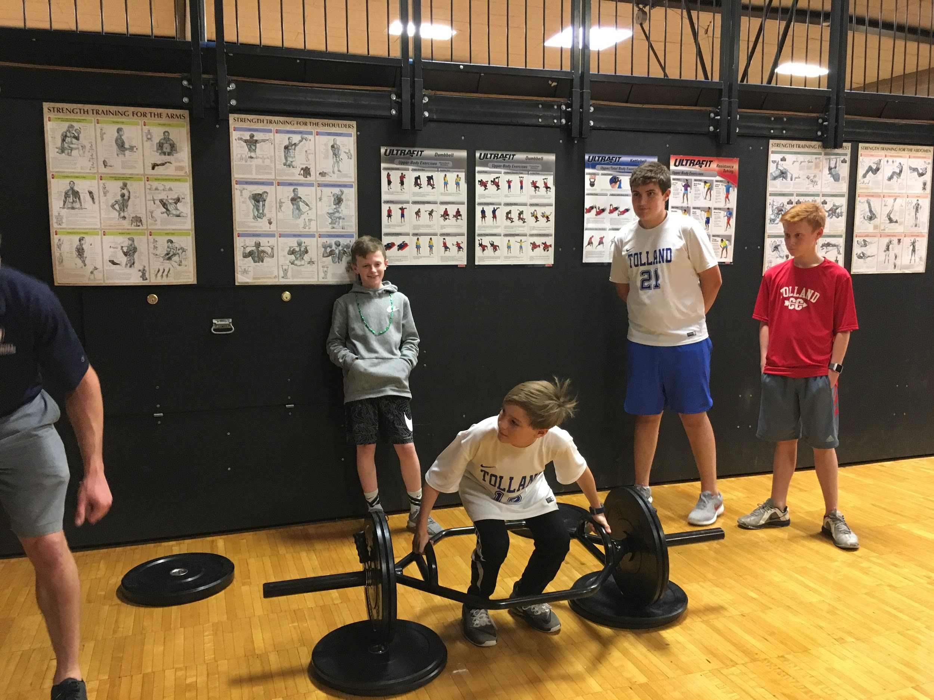
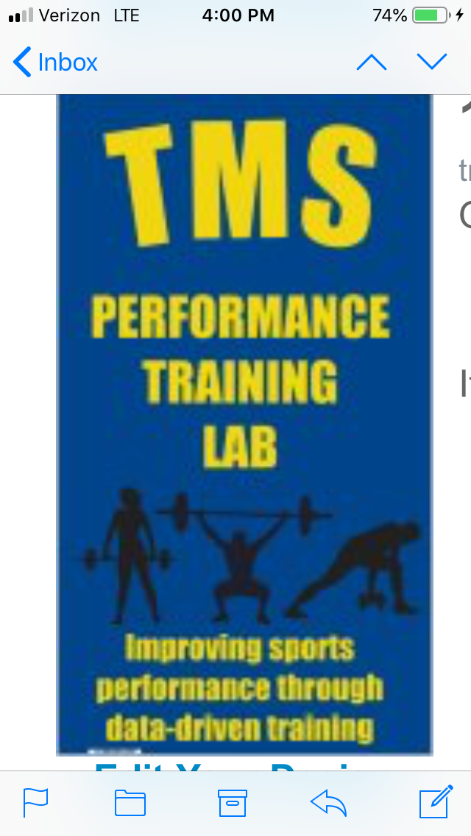
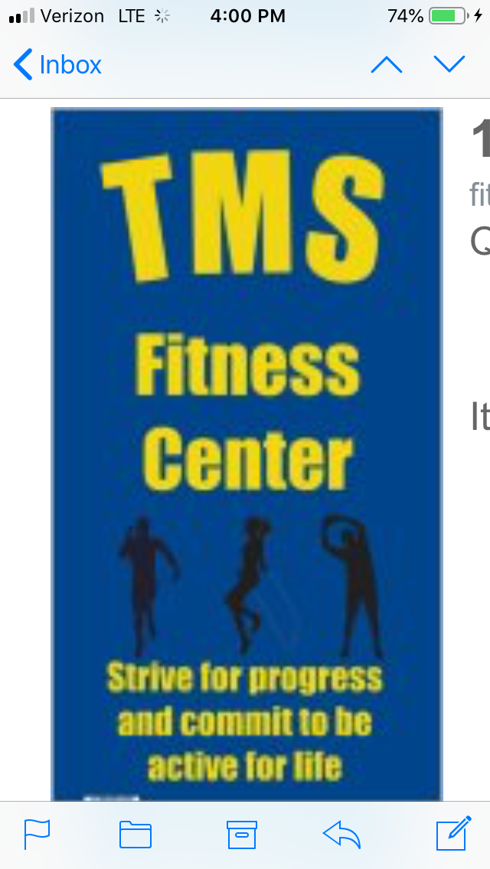
More news...Performance Training Lab/
Fitness Room in
the mini gym for expanded
offerings by the PE teachers!
25 spin bikes (use with health instruction as well)
40 ft. traversing wall
Strength and conditioning equipment
Group heart rate monitors
Vertical laser system

Slide 4
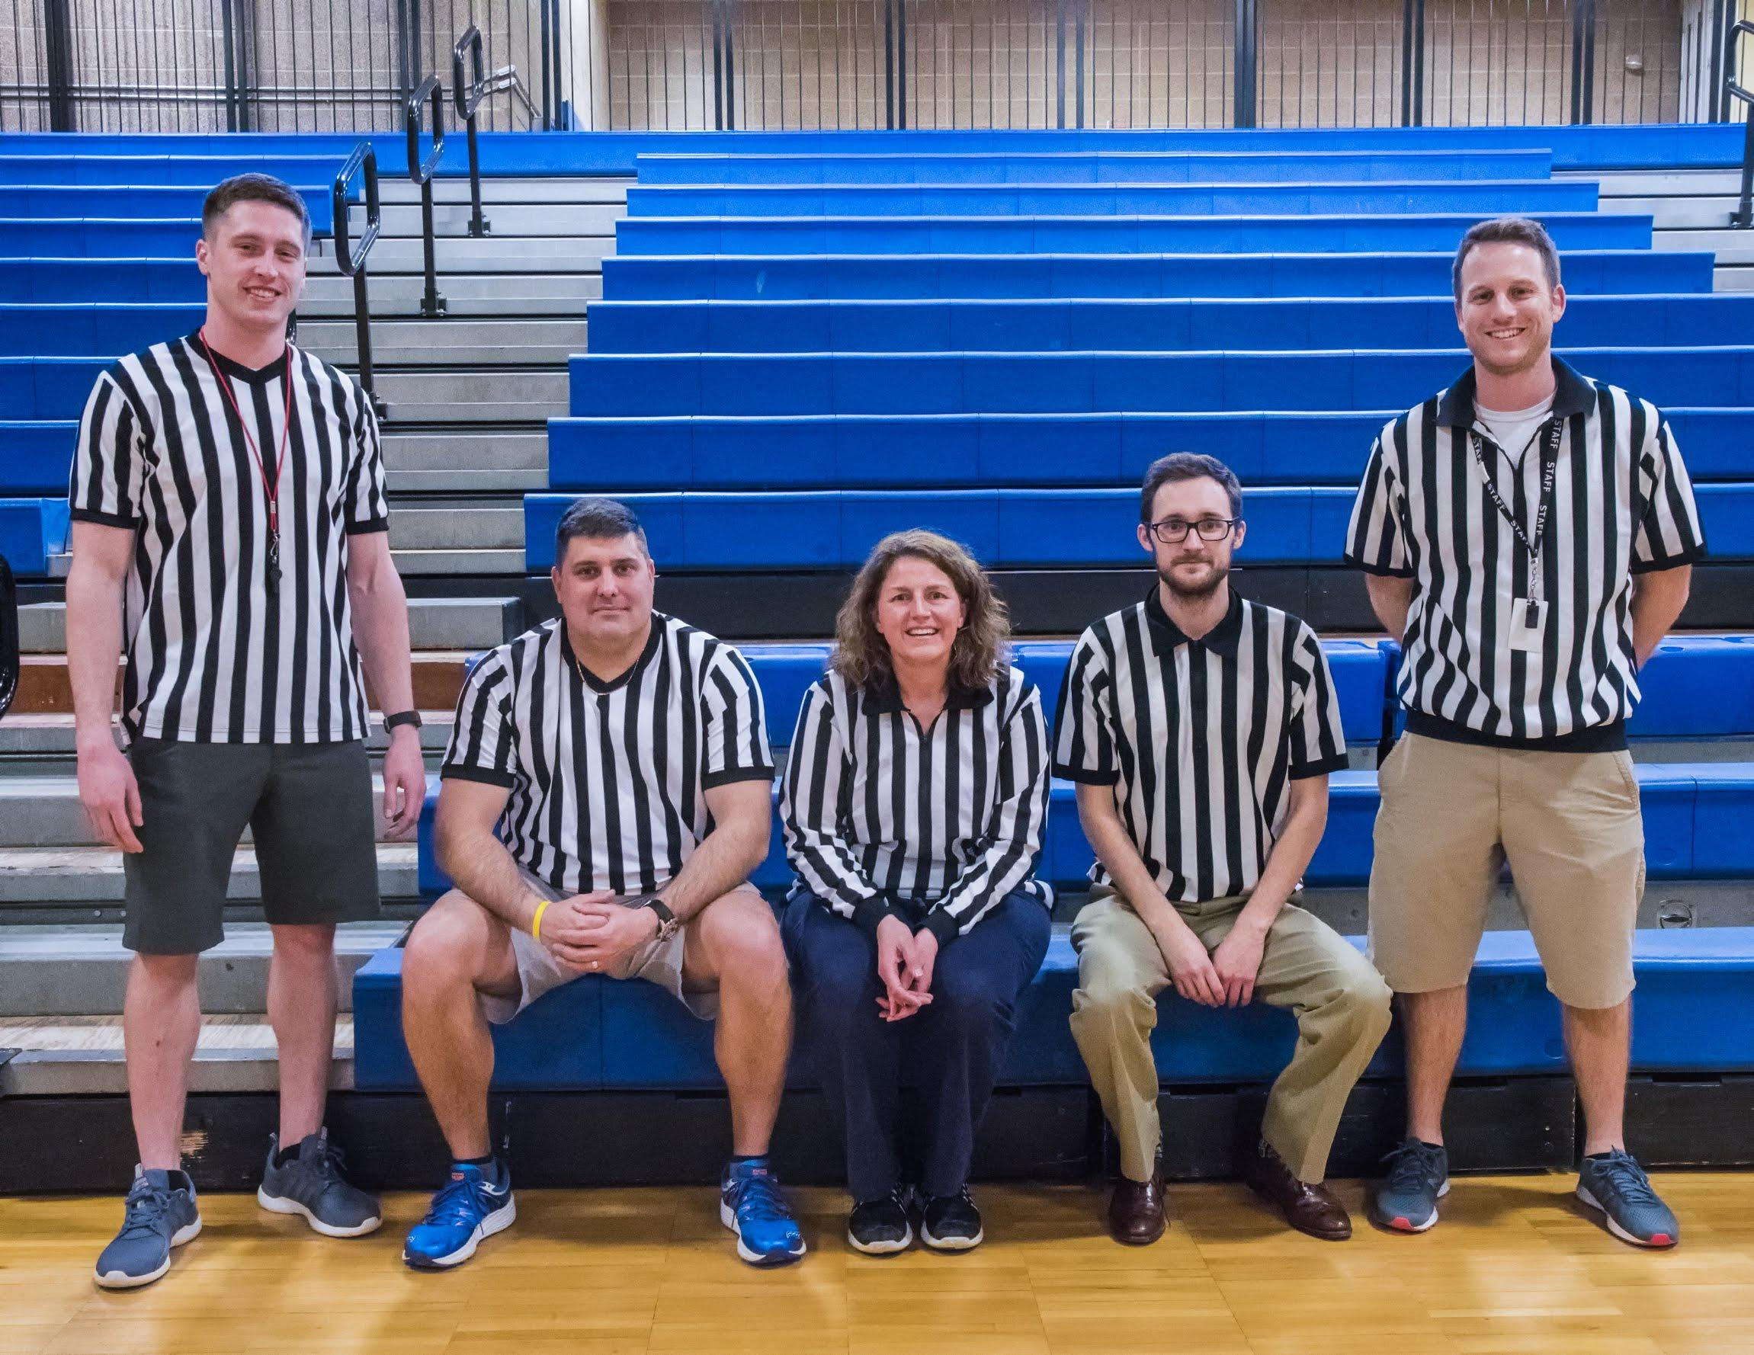
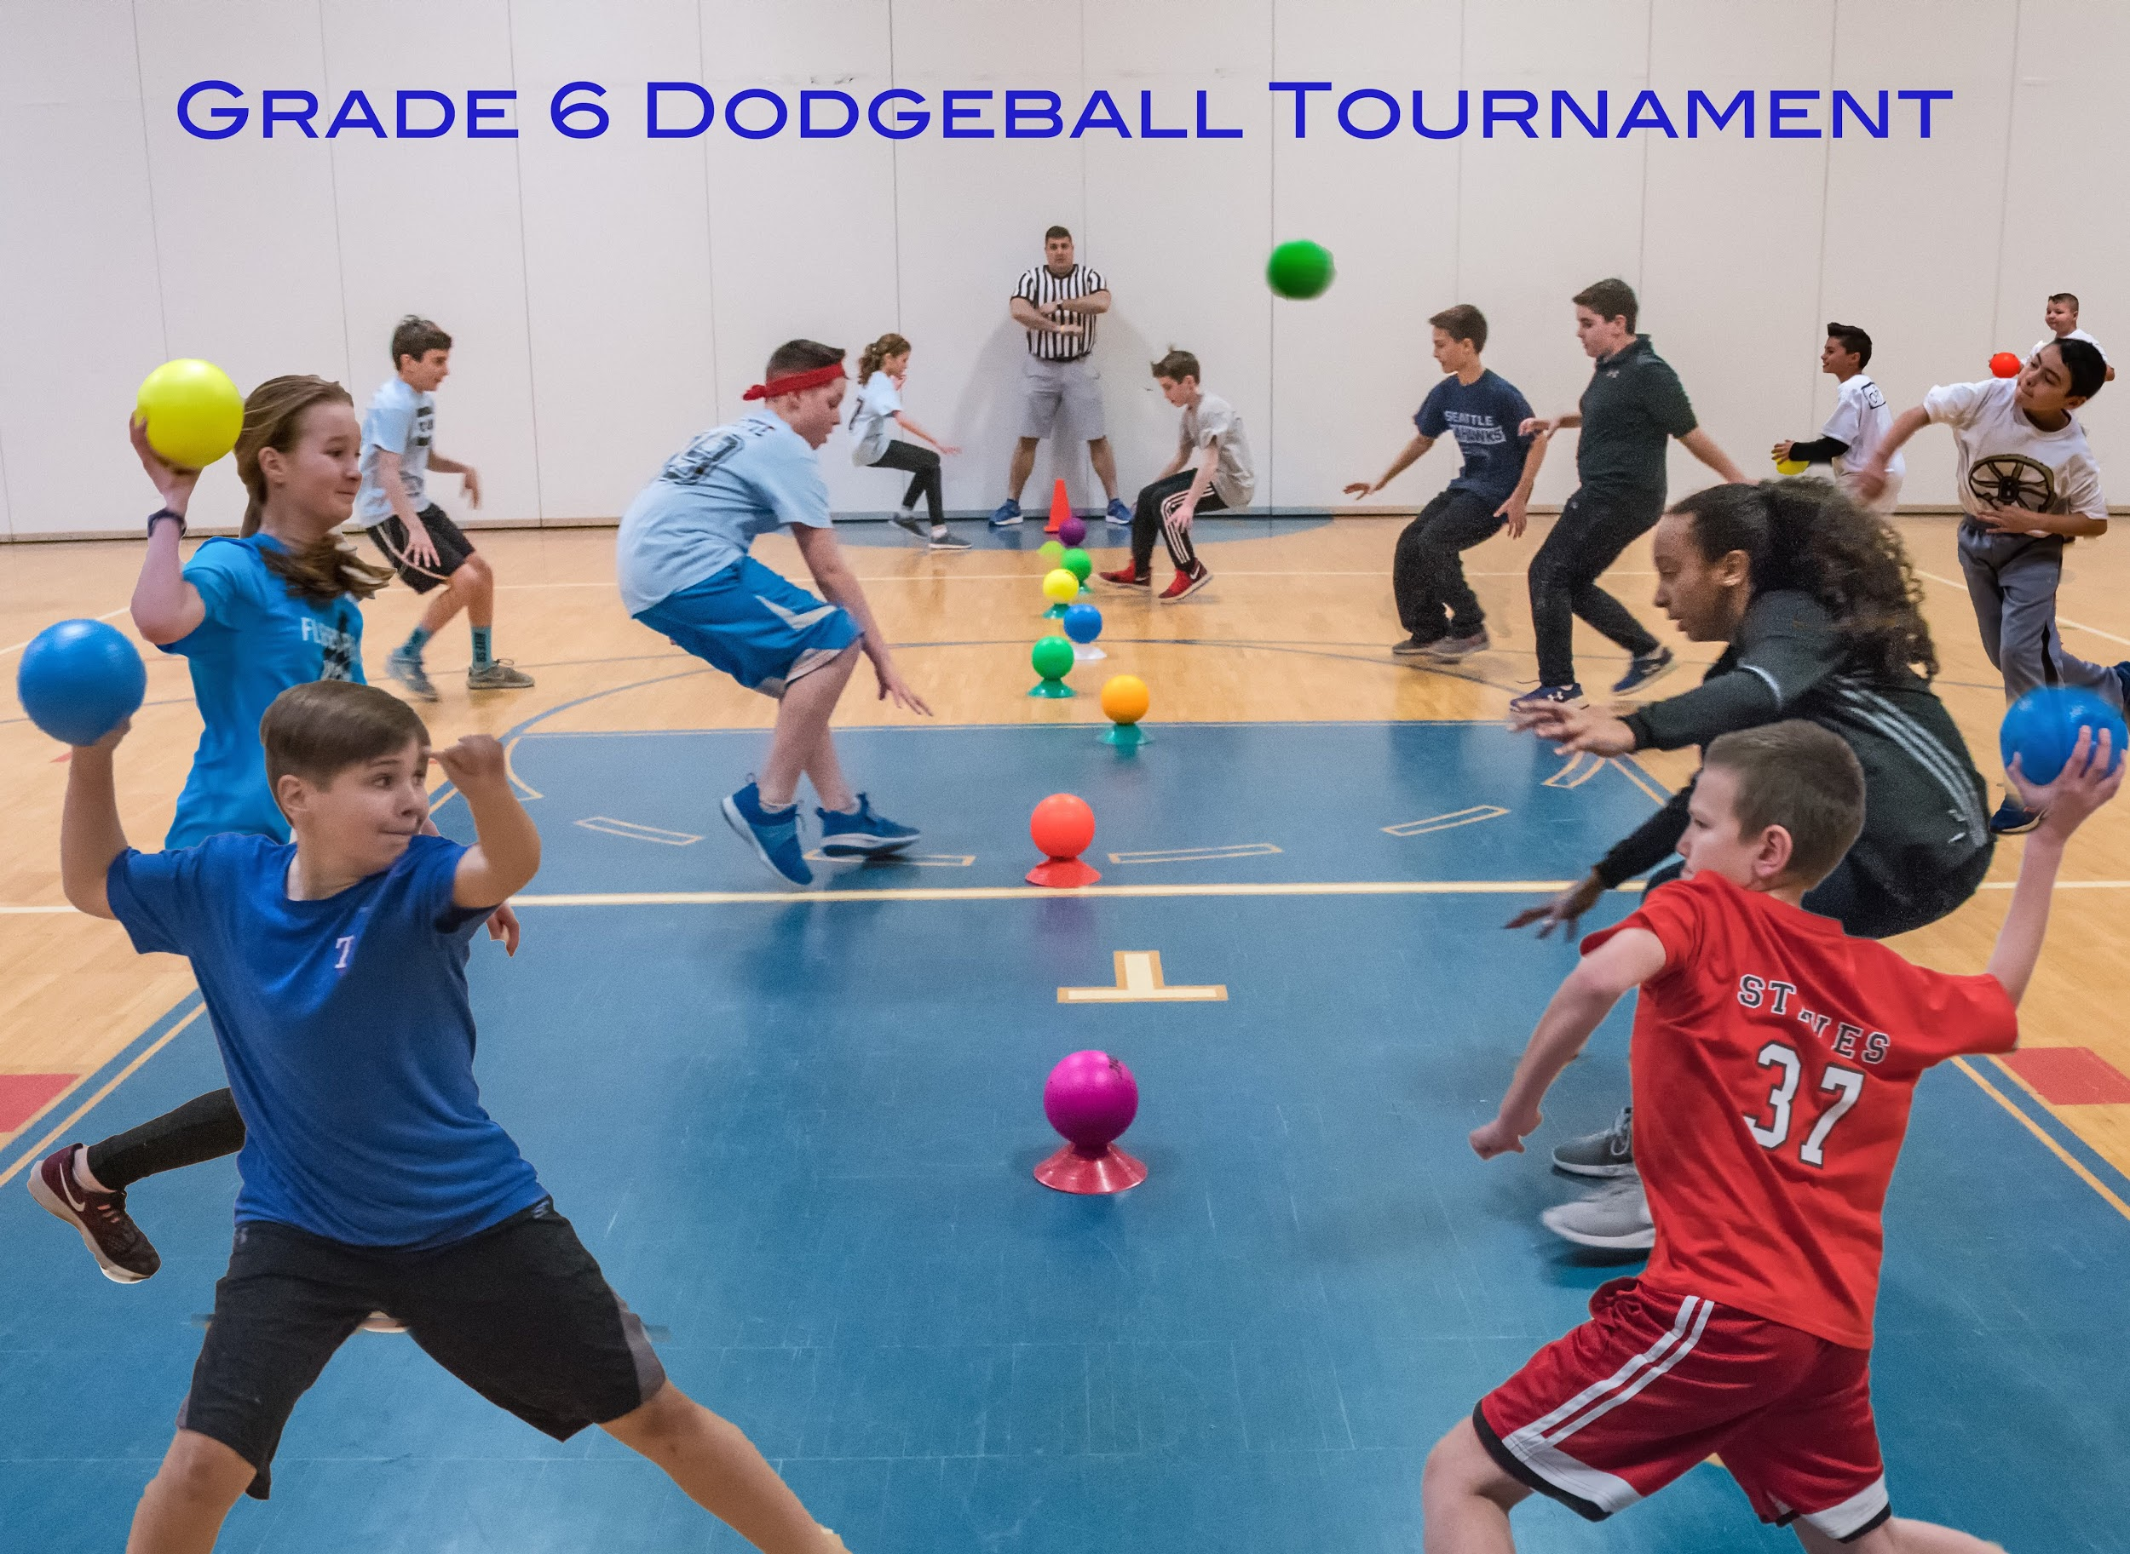
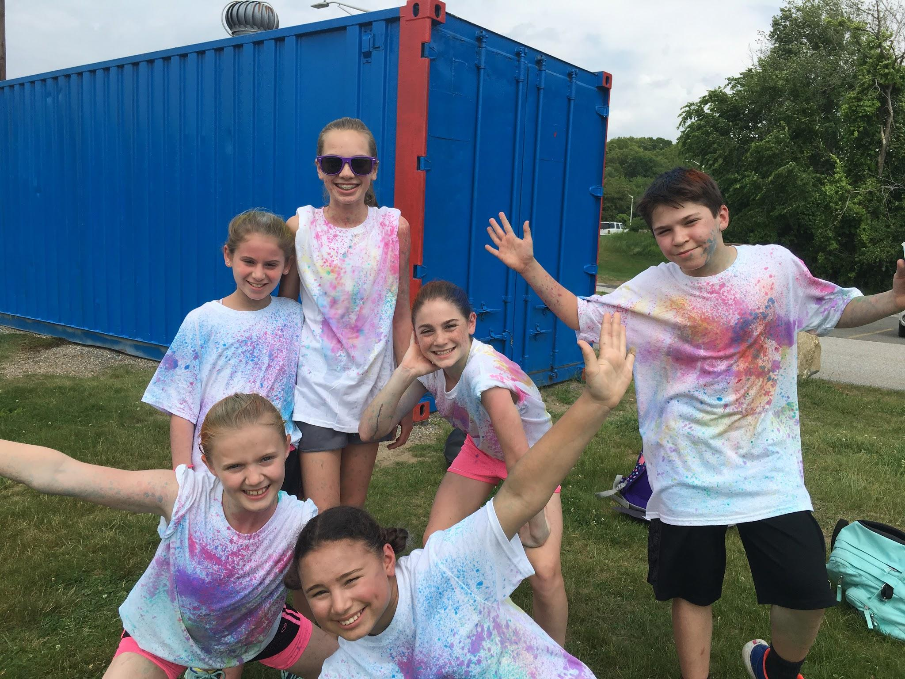
Fundraising and grants..Why not??
Paint runs
Dodgeball tournaments
Raised over $30,000 for PE

Slide 5
PE SOAR REWARD DAYS for PBIS
Oct. 4 and 5
Nov. 8 and 9
Dec. 20 and 21
Feb. 13 and 14
April 11 and 12
May 23 and 24
June- (TBD)
Criteria for participation: You must have your SOAR status and no lunch
detentions from PE or Health class from reward day to the next reward day.

Slide 6
Mastery grading system and Google Classroom
Extensive use of Google Classroom
Mastery learning and grading for all PE units
Variety of authentic assessments
Student led lessons and project based learning
Inclusion and Adaptive PE

Slide 7
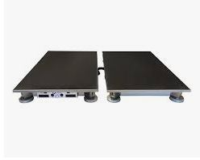
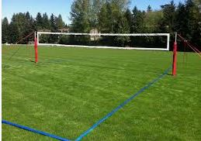
What’s next?
2 outdoor grass volleyball courts near the track area, and a force plate (May 2019).

